Slide 1
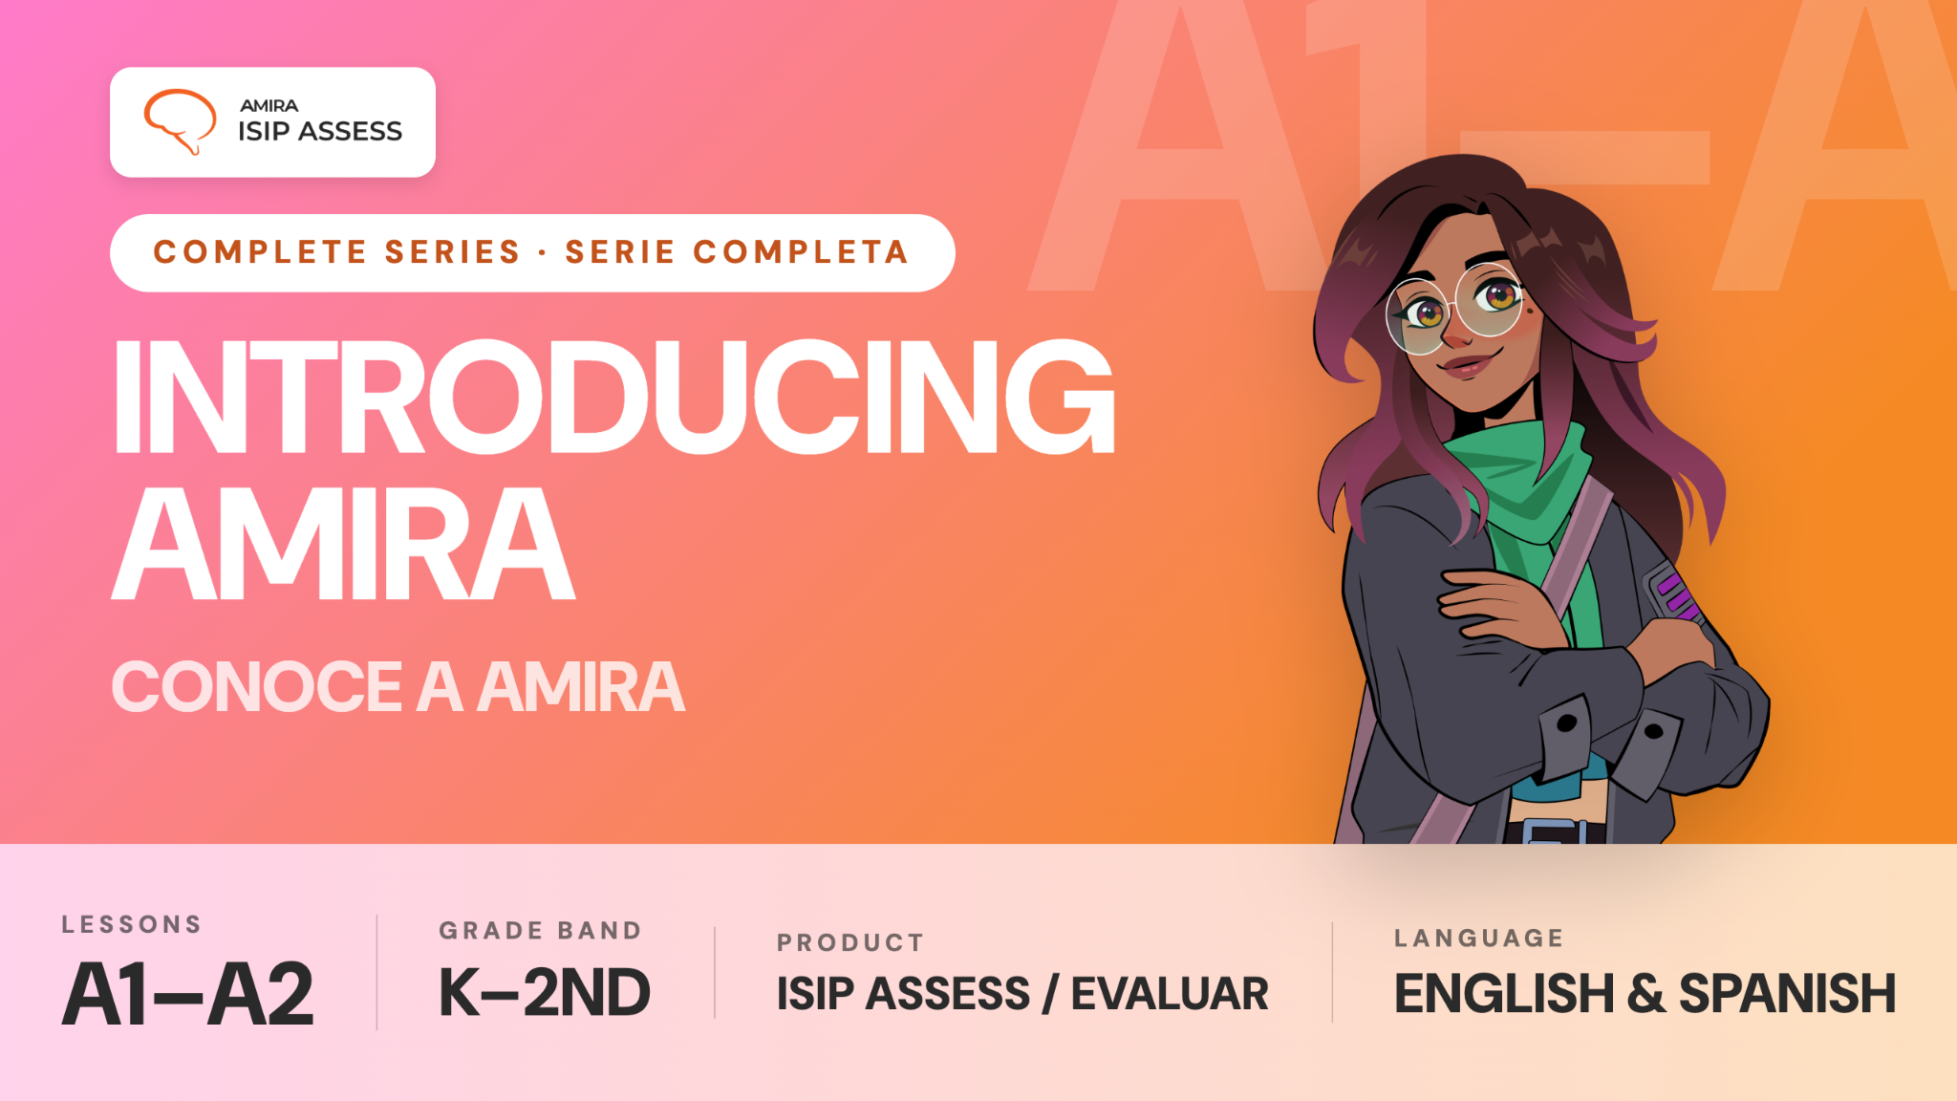

Slide 2
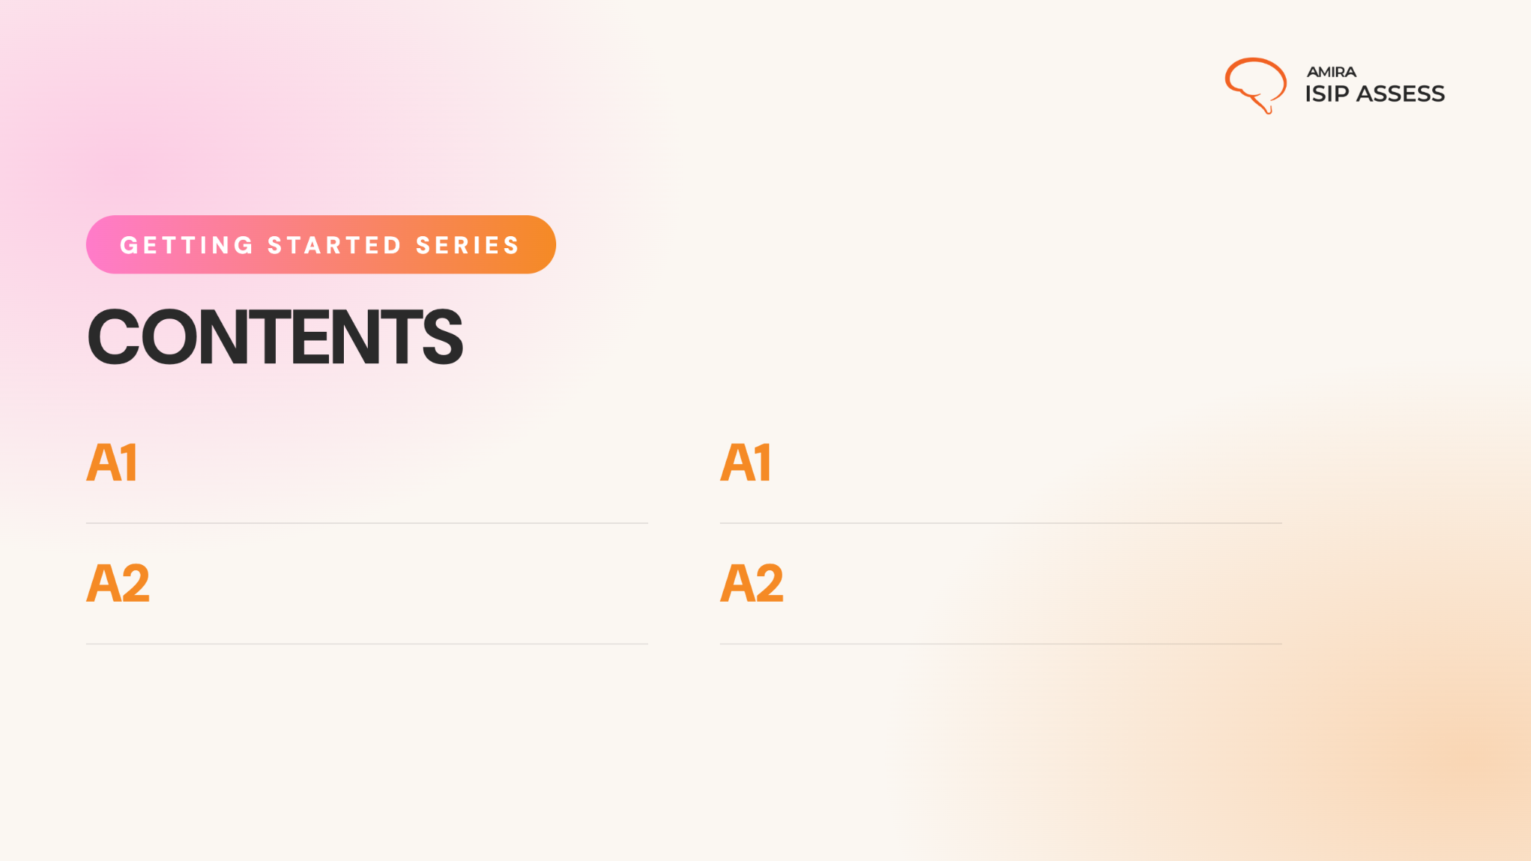
About Assess
Show students how the benchmark works and why Amira needs to hear them.
Acerca de Evaluar
Enseñe a los estudiantes cómo funciona la evaluación y por qué Amira necesita escucharlos.
Listening Comprehension
Teach students how to retell a story in their own words after listening carefully.
No corresponde: Evaluar no incluye una actividad de recuento oral.
Not applicable: Evaluar does not include an oral retell task.

Slide 3
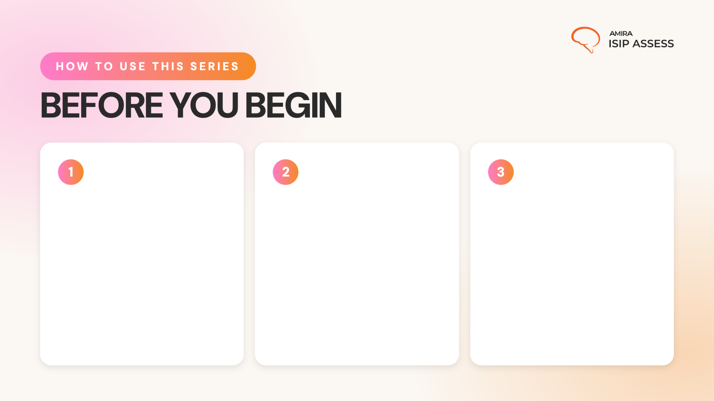
Preview the Content
Watch the videos and read through the full presentation to get familiar with the lesson flow student content.
Note: The story featured in Lesson A2 was created specifically for this lesson and will not appear in the ISIP assessment.
Add Custom Info
Update the prompts as needed and add any school-specific details.
Bring the Energy
Plan to introduce the series with energy and confidence. When students see that you value these routines, they are more likely to understand their importance and commit to using them.

Slide 4
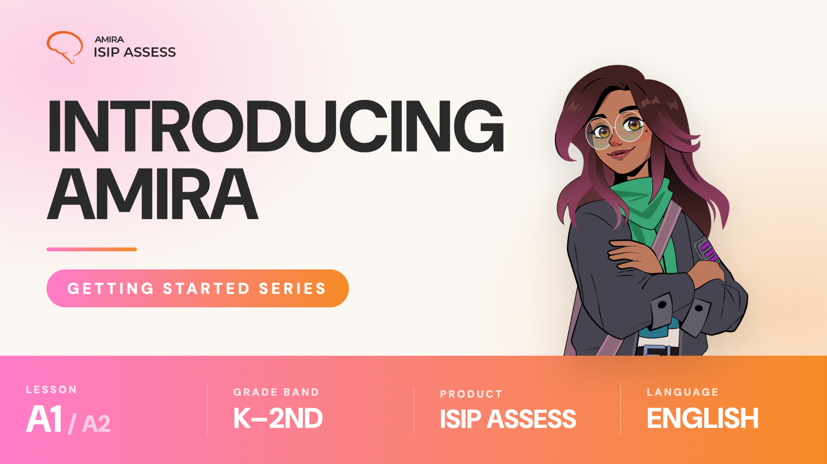

Slide 5

Notes:
https://vimeo.com/amiralearning/k2-a1

Slide 6

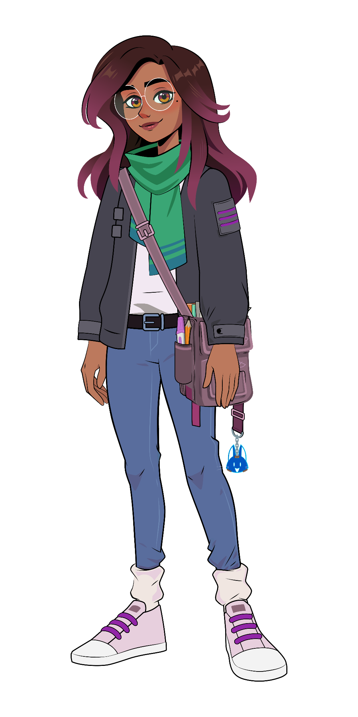

Lesson A1:
Check for understanding:
What should you wait for before you begin reading or speaking?
What should you do if a part feels tricky?
Think deeper:
Why is it important to try your best, even when something feels hard?

Slide 7


Slide 8
Notes:
https://vimeo.com/amiralearning/k2-a2
NOTE: The story featured in Lesson A2 was created specifically for this lesson and will not appear in the ISIP assessment.

Slide 9
Lesson A2:
The Tiny Dragon
Who is the story about?
Where does the story take place?
What happened first, next and last?
What other details are important to the story?

Slide 10
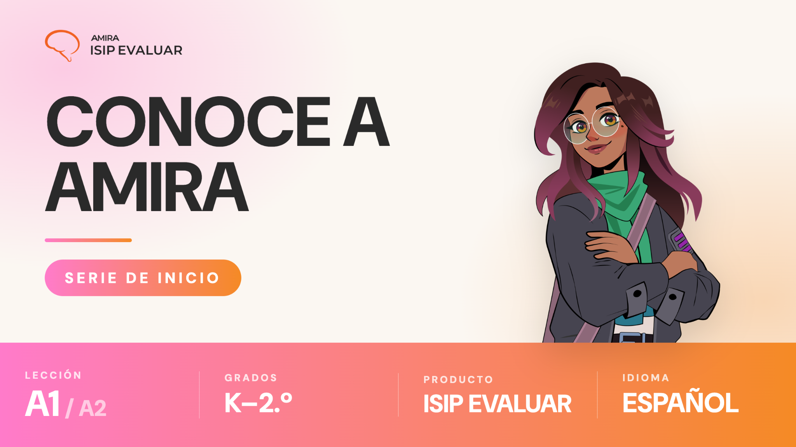

Slide 11
Notes:
https://vimeo.com/amiralearning/k2-a1-sp

Slide 12
Lección A1
Comprueba tu comprensión:
¿Qué debes esperar antes de empezar a leer o hablar?
¿Qué debes hacer si una parte te parece difícil?
Piensa más a fondo:
¿Por qué es importante hacer tu mejor esfuerzo, incluso cuando algo parece difícil?

