Slide 1
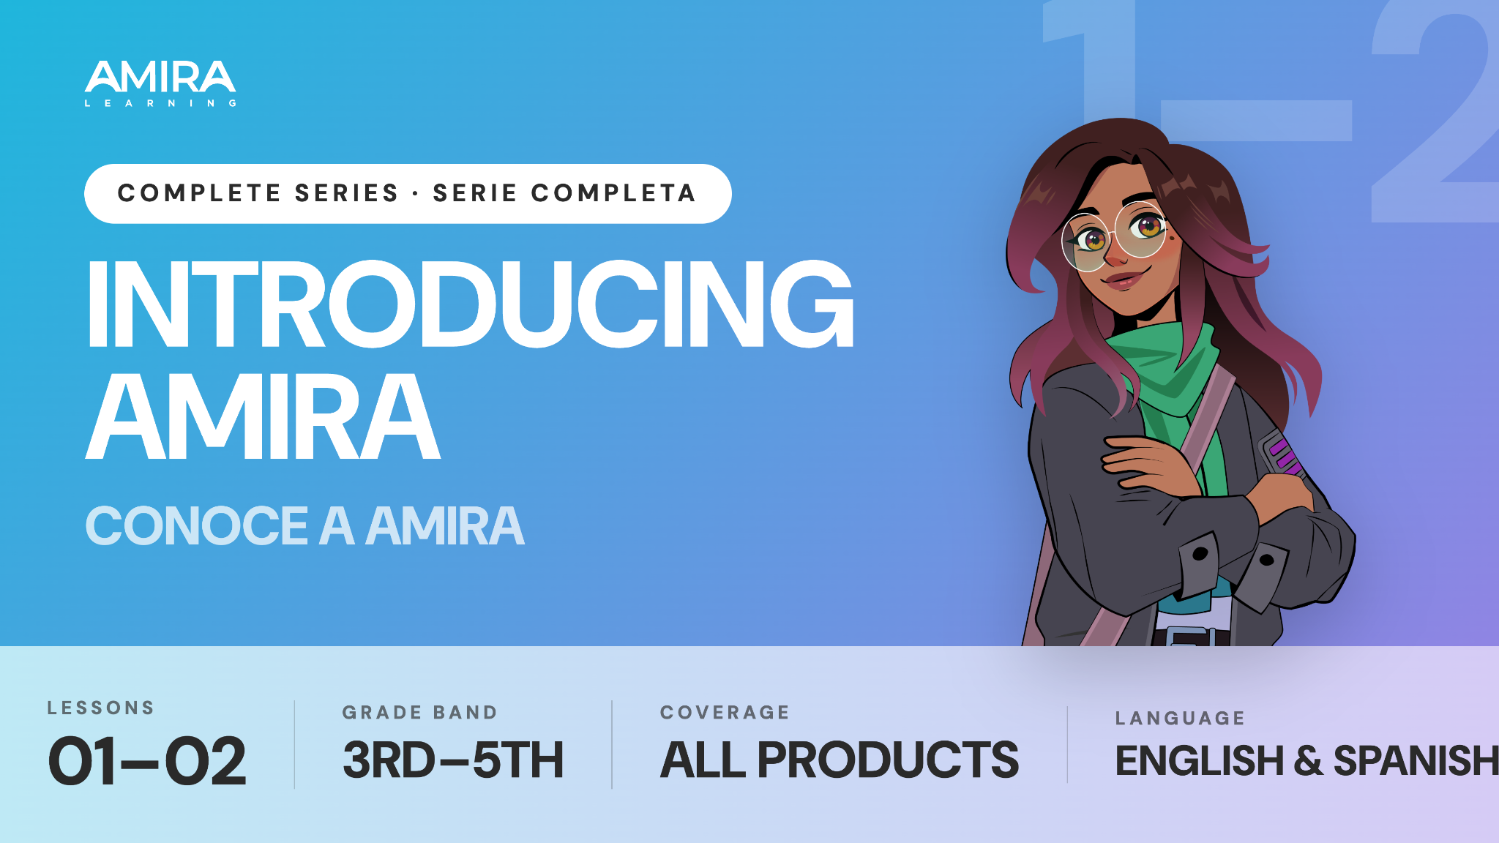

Slide 2
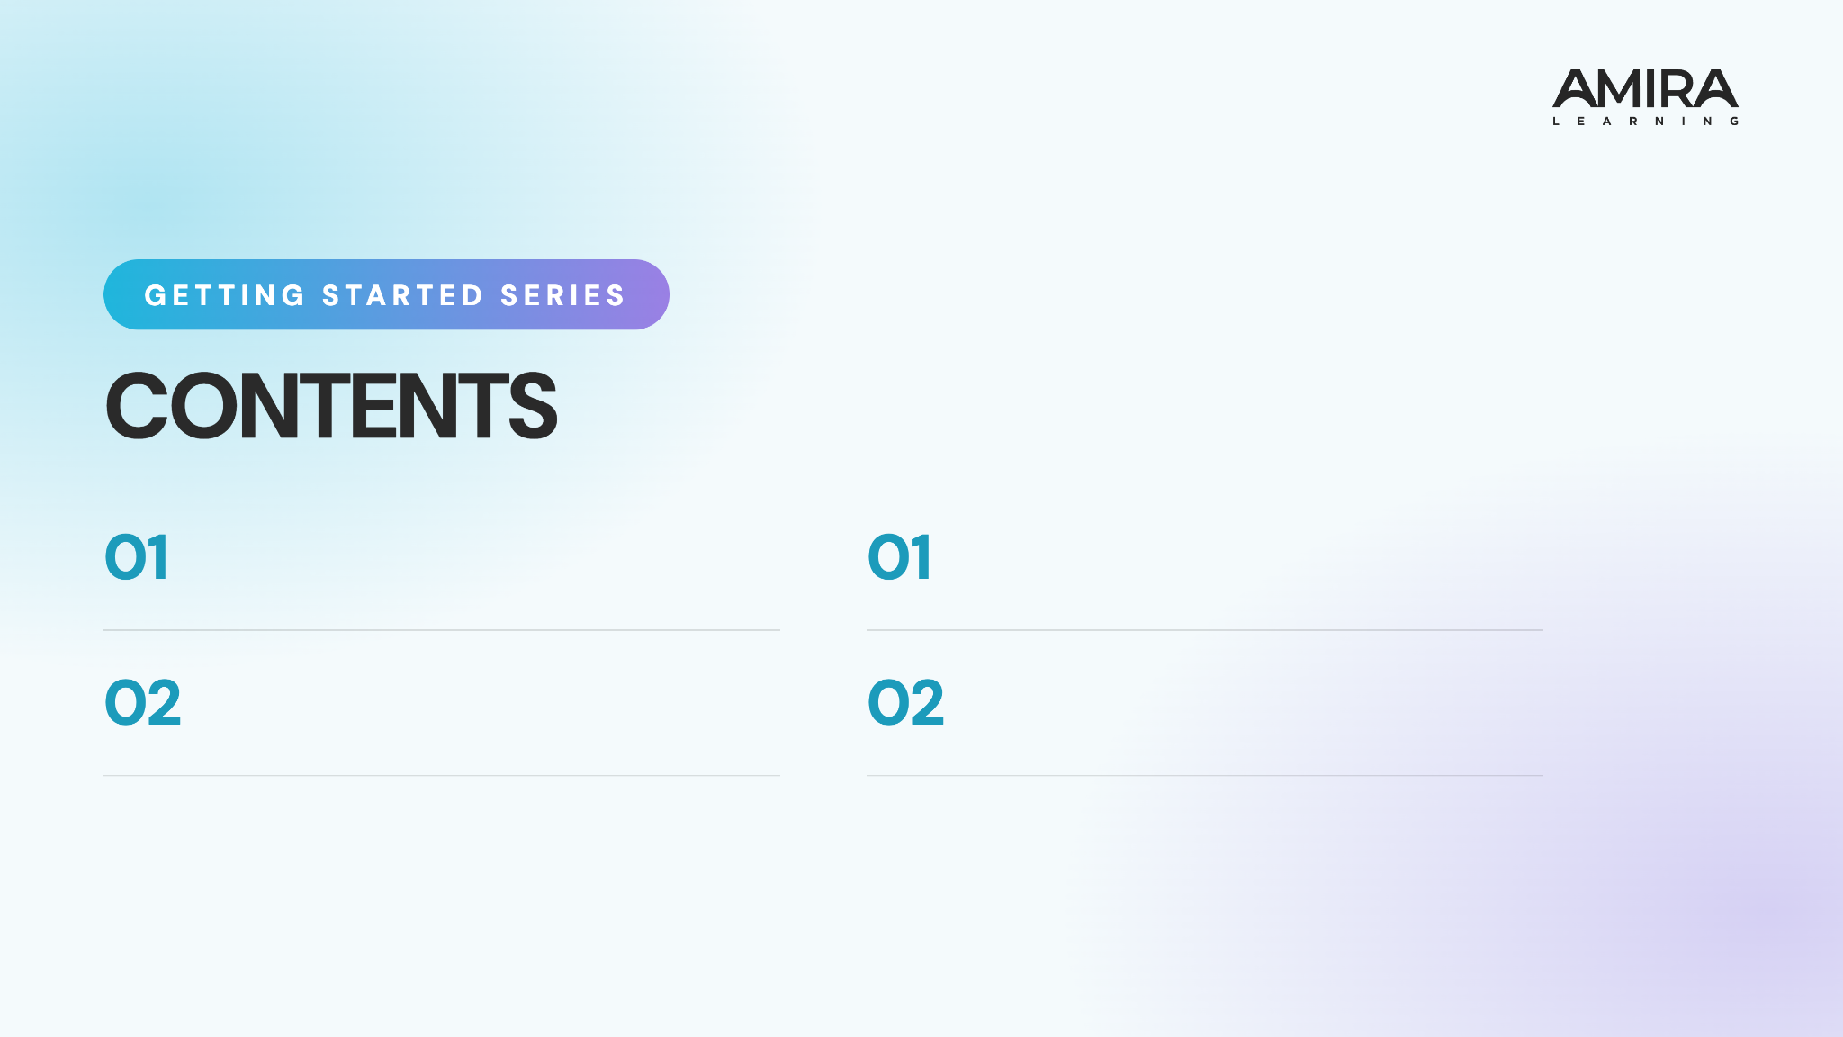
Logging In
Show students who Amira is and how to log in.
Iniciar sesión
Muestra a los alumnos quién es Amira y cómo iniciar sesión.
Tips for Success
Teach students best practices for reading with Amira.
Consejos para tener éxito
Enseña a los estudiantes las mejores prácticas para leer con Amira.

Slide 3
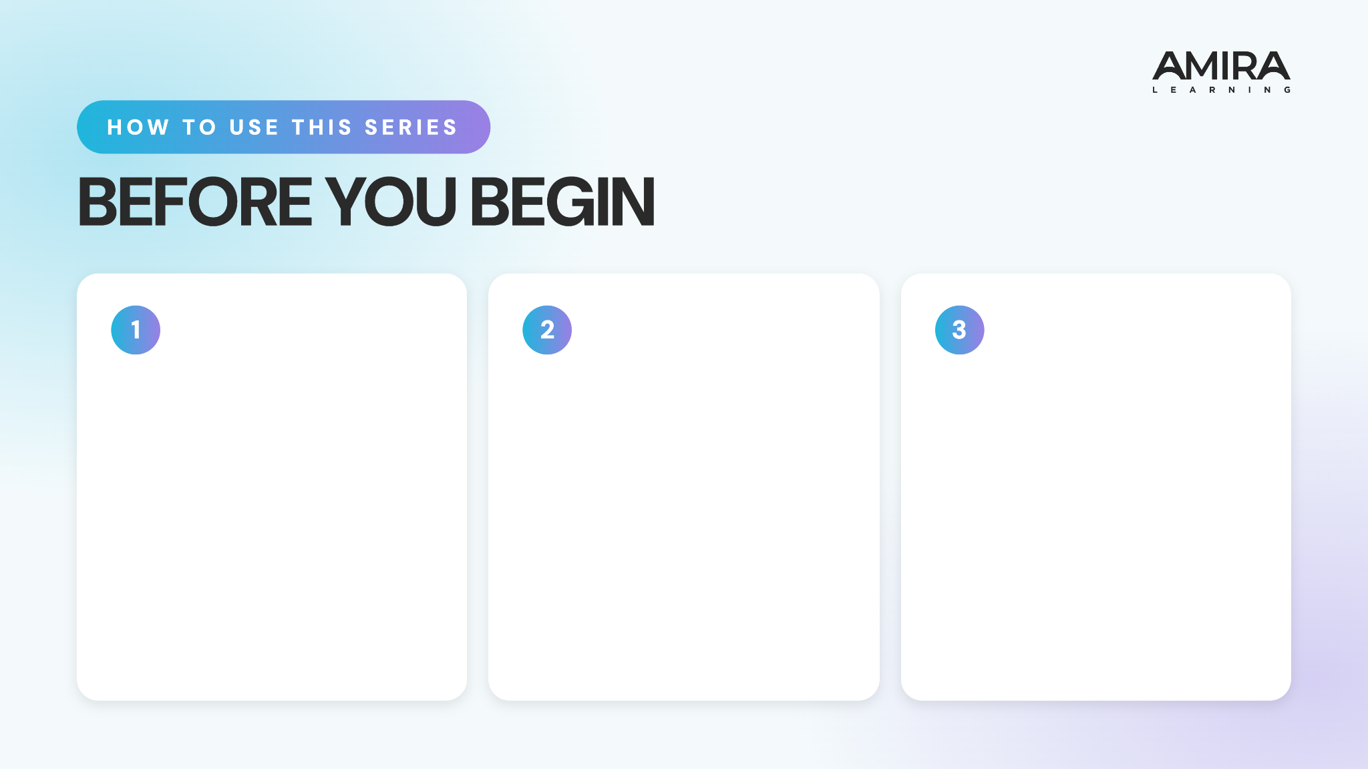
Preview the Content
Watch the videos and read through the full presentation to get familiar with the lesson flow student content.
Add Custom Info
Customize the login slides with your school’s platform, devices, and login instructions. Update the prompts as needed and add any school-specific details.
Bring the Energy
Plan to introduce the series with energy and confidence. When students see that you value these routines, they are more likely to understand their importance and commit to using them.

Slide 4
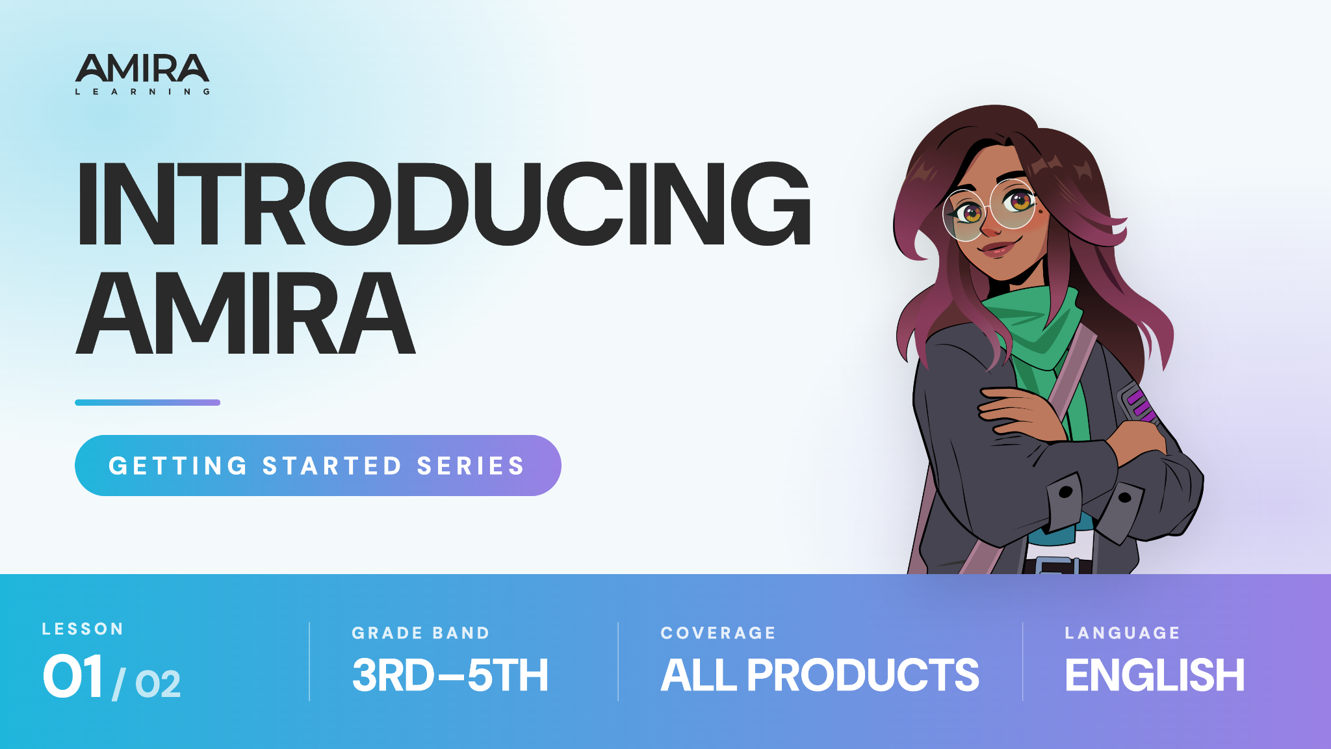

Slide 5

Notes:
https://vimeo.com/amiralearning/gs-35-1

Slide 6

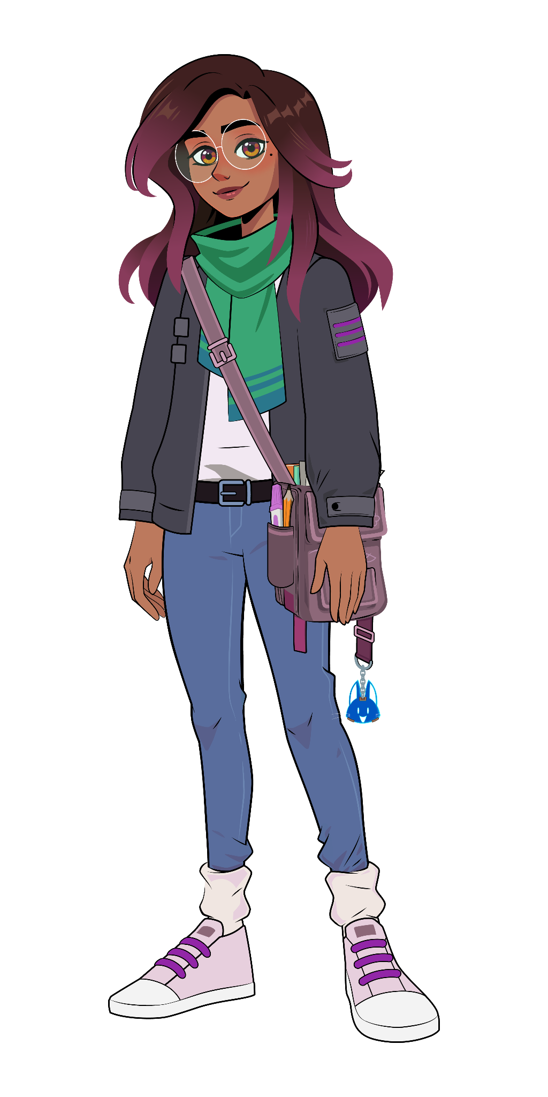

Lesson 1: Logging In
Follow these steps from your teacher:
[Insert Text]
[Insert Text]
[Insert Text]
[Insert Text]

Slide 7
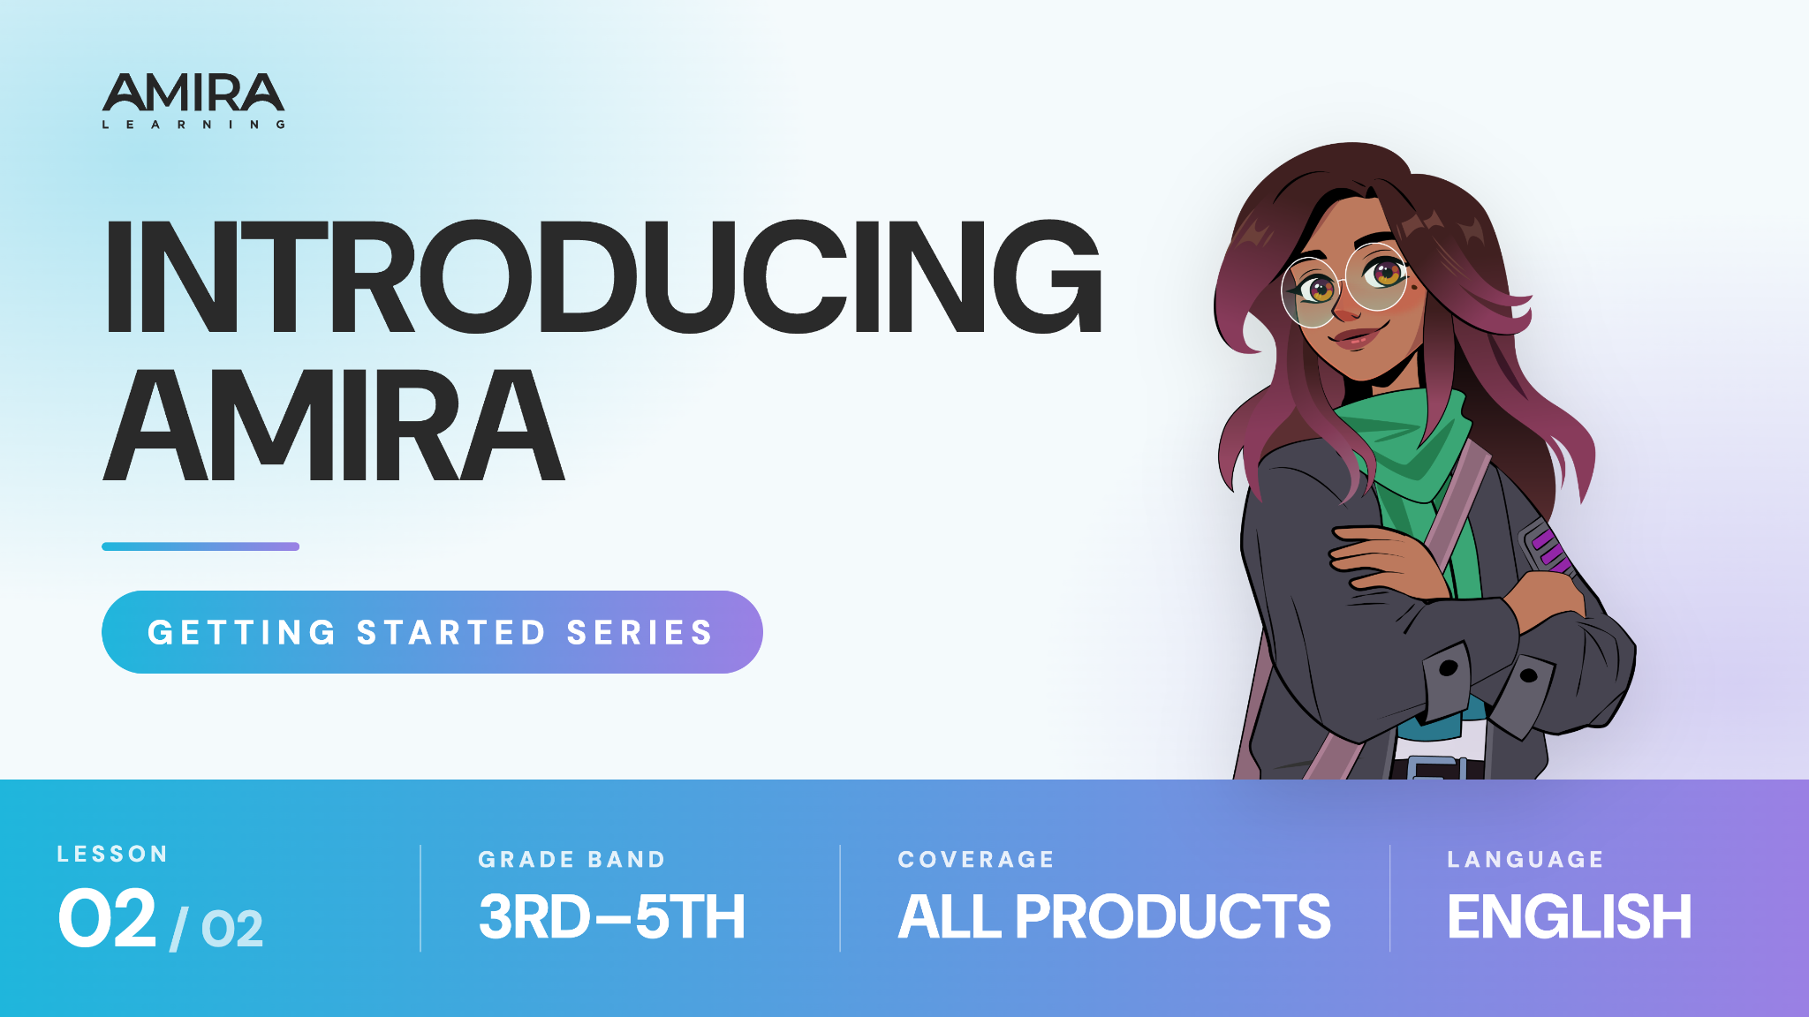

Slide 8

Notes:
https://vimeo.com/amiralearning/gs-35-2

Slide 9
Lesson 2:
What should you keep in mind when reading to Amira?
Why is it important for Amira to hear you clearly?

Slide 10
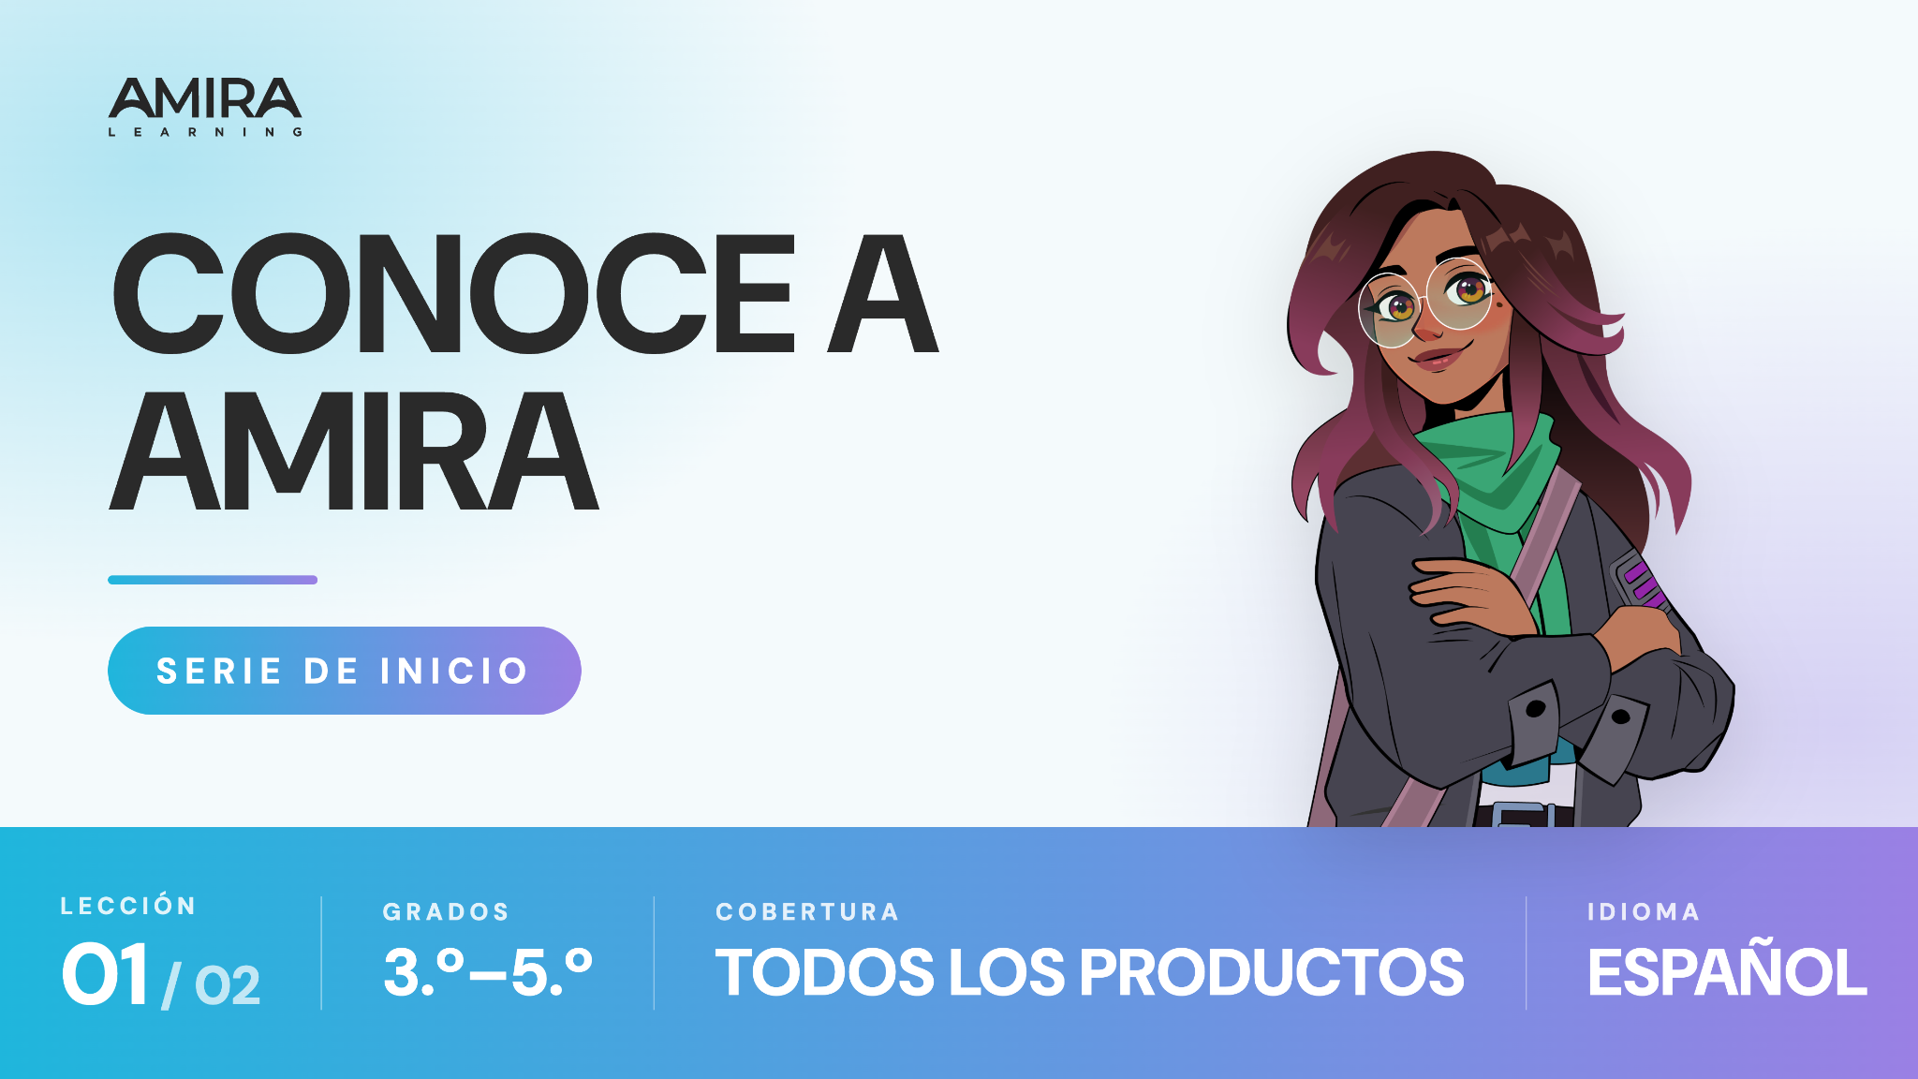

Slide 11
Notes:
https://vimeo.com/amiralearning/gs-35-1-sp

Slide 12
Lección 1
Sigue estos pasos que te dará tu profesor:
[Insertar texto]
[Insertar texto]
[Insertar texto]
[Insertar texto]

Slide 13


Slide 14

Notes:
https://vimeo.com/amiralearning/gs-35-2-sp

Slide 15
Lección 2:
¿Qué debes tener en cuenta cuando lees con Amira?
¿Por qué es importante que Amira te escuche con claridad?

