Slide 1
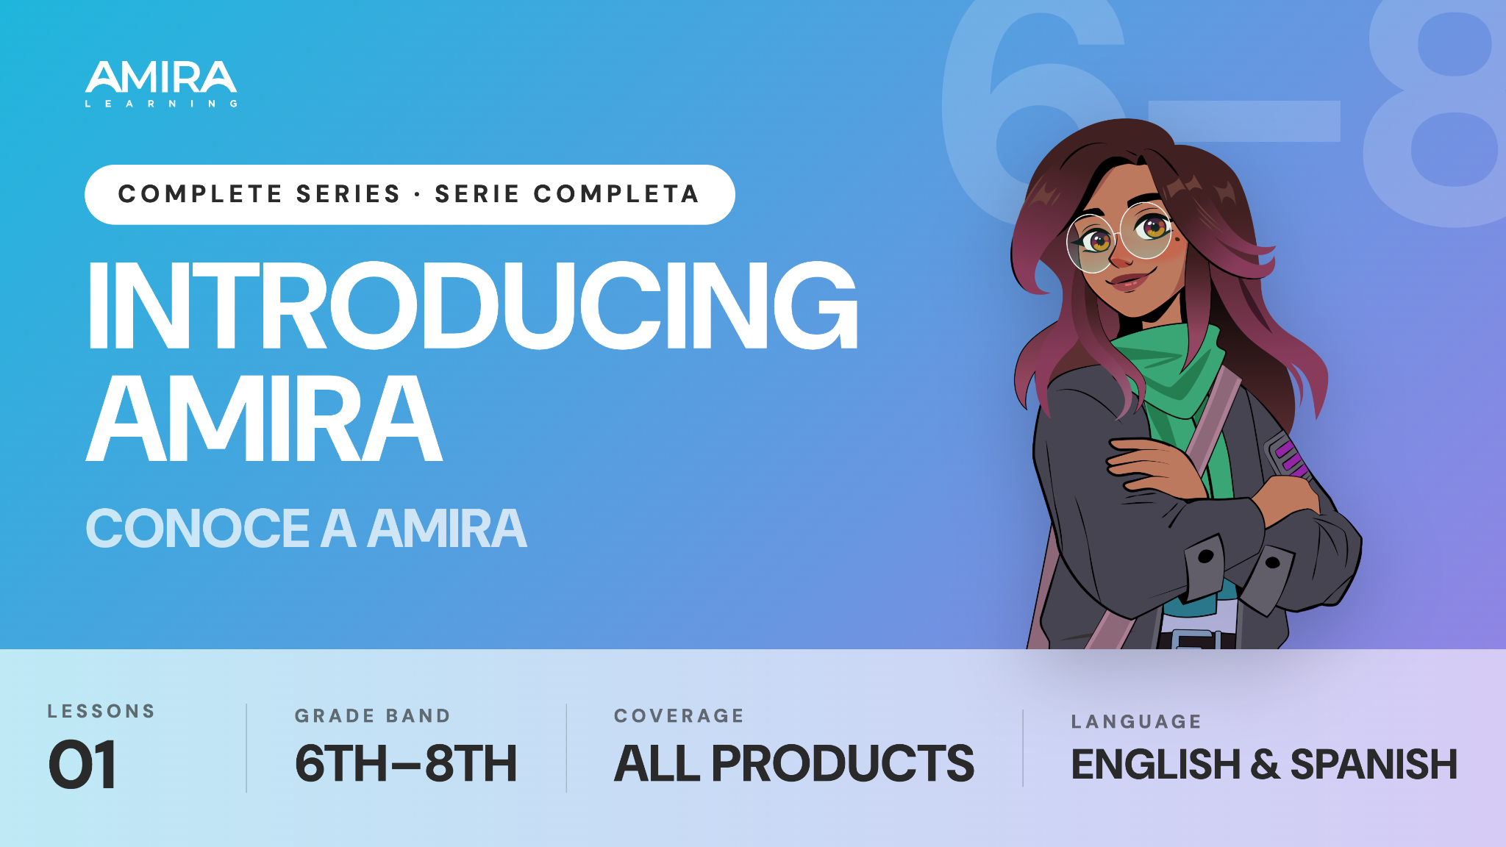

Slide 2
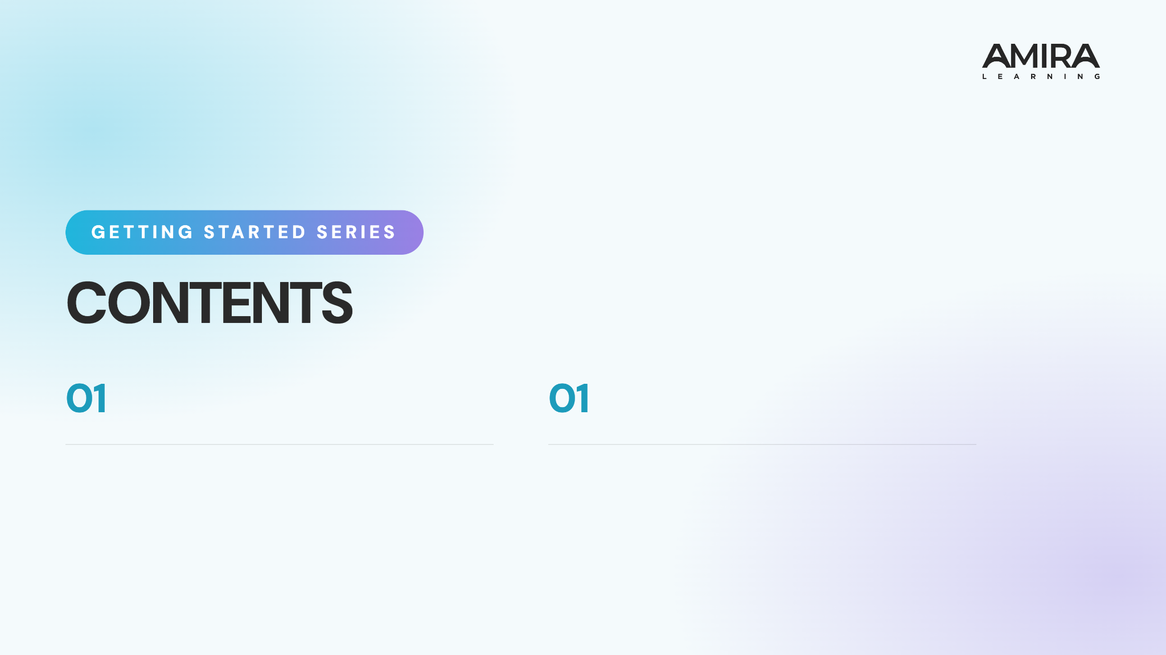
Logging in & Tips
Show students how to log in and share best practices for reading with Amira.
Iniciar sesión y consejos para tener éxito
Muestra a los estudiantes cómo iniciar sesión y comparte las mejores prácticas para leer con Amira.

Slide 3
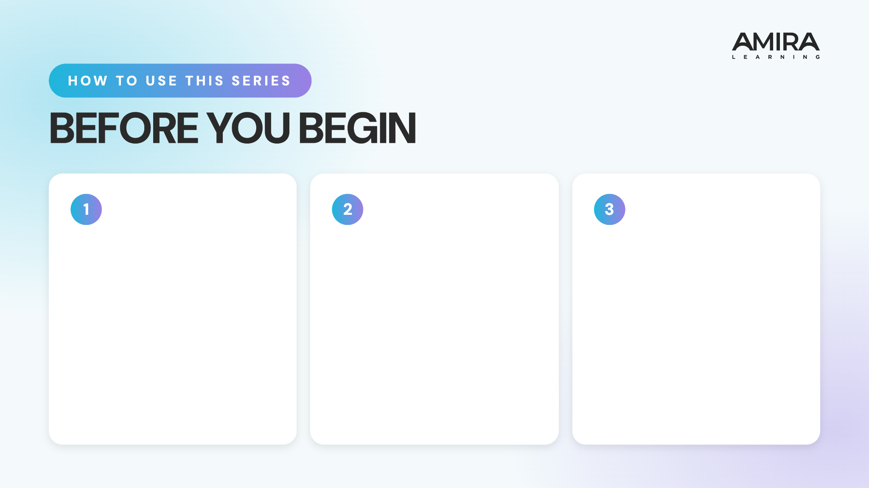
Preview the Content
Watch the videos and read through the full presentation to get familiar with the lesson flow student content.
Add Custom Info
Customize the login slides with your school’s platform, devices, and login instructions. Update the prompts as needed and add any school-specific details.
Bring the Energy
Plan to introduce the series with energy and confidence. When students see that you value these routines, they are more likely to understand their importance and commit to using them.

Slide 4
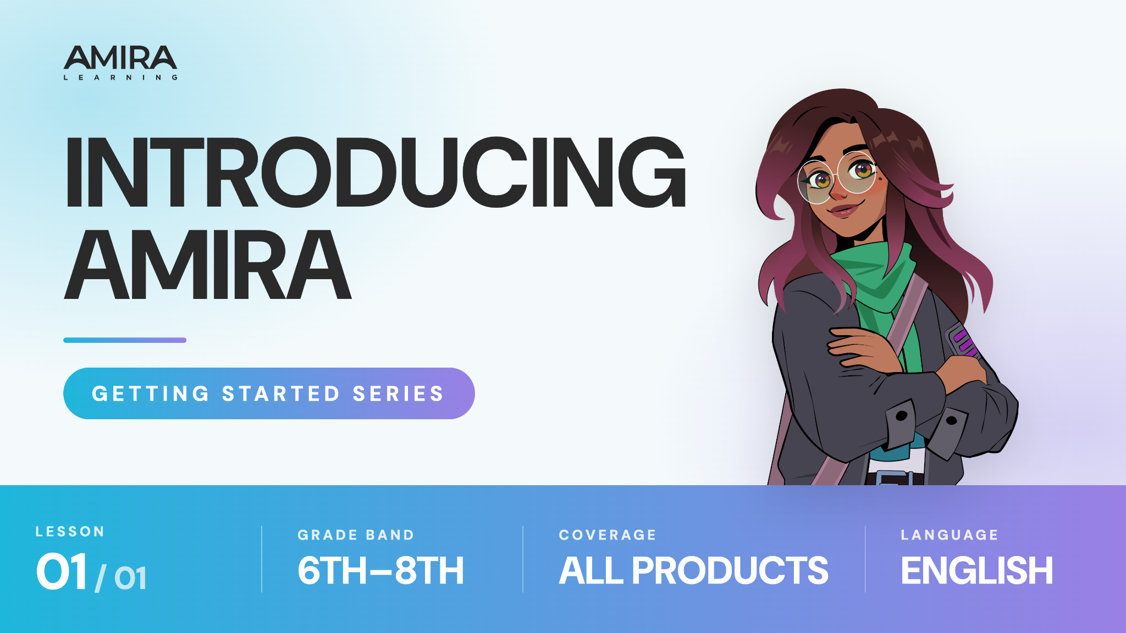

Slide 5

Notes:
https://vimeo.com/amiralearning/gs-68

Slide 6

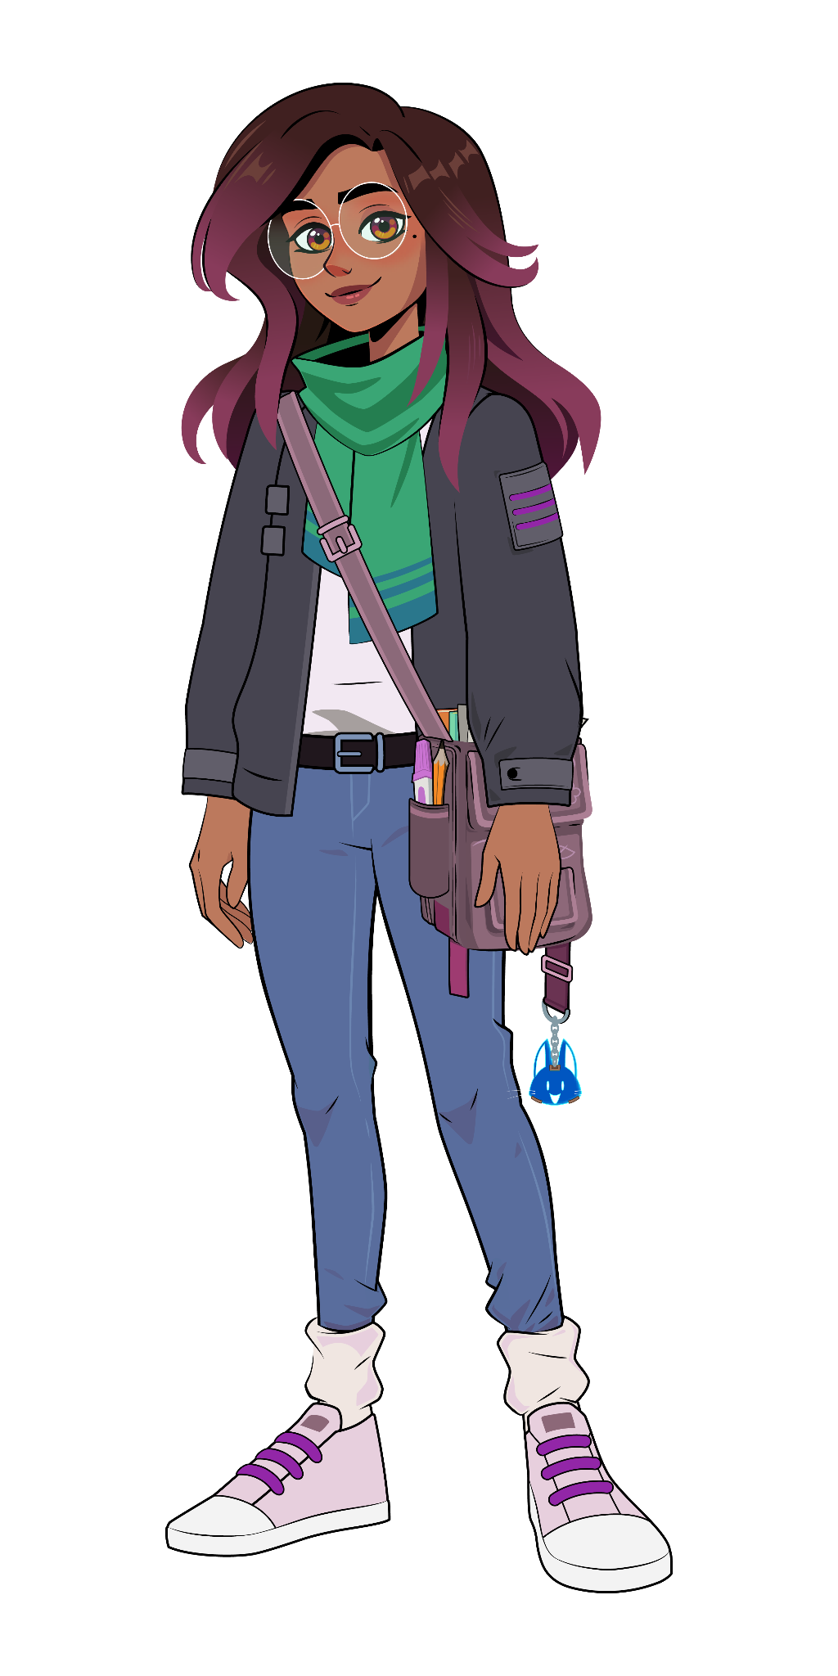

Lesson 1: Logging In
Follow these steps from your teacher:
[Insert Text]
[Insert Text]
[Insert Text]
[Insert Text]

Slide 7
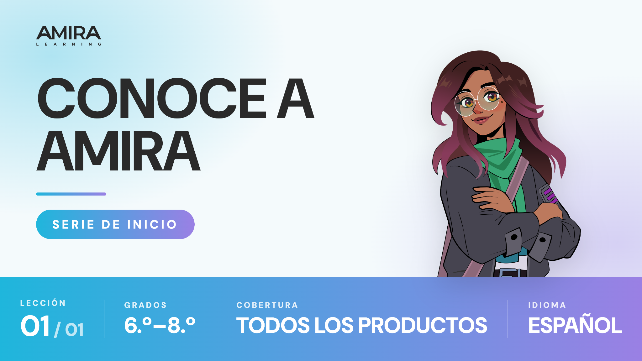

Slide 8
Notes:
https://vimeo.com/amiralearning/gs-68-sp

Slide 9
Lección 1
Sigue estos pasos que te dará tu profesor:
[Insertar texto]
[Insertar texto]
[Insertar texto]
[Insertar texto]

